Slide 1
Seattle Golf Demand during Winter Months
By: Eric Browne, Oscar Pachon

Slide 2
Segments
Part 1: Introduction, and Initial OLS Regression
Part 2: F-Wald Tests, Auxillary Regression
Part 3:Heteroskedasticity and Weighted Regression
Part 4: Conclusion

Slide 3
Part 1: Introduction, and Initial Regression
Presented by Oscar Pachon

Slide 4
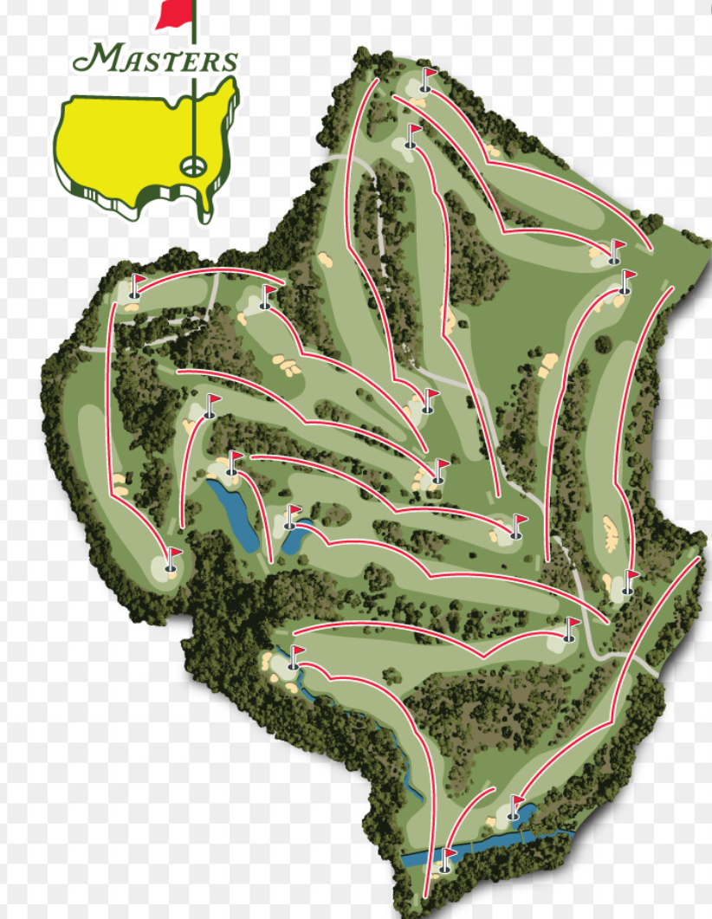
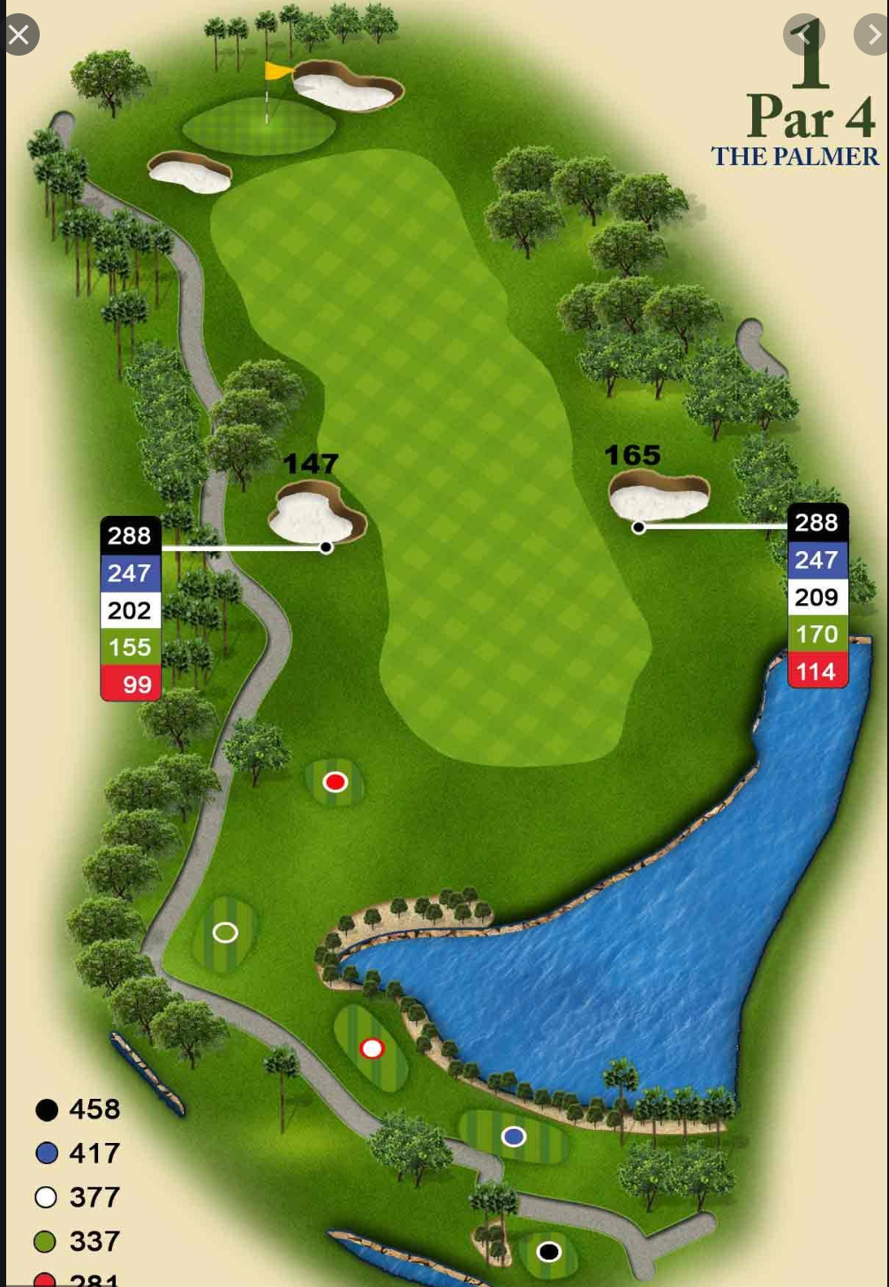
How is Golf Played?
One Round = 18 or 9 Holes
Played Outside
Some courses harder than others
The difficulty is described in the Rating of the Course (RATING)
Other Difficulty Factors include: the slope, and the length,

Slide 5
Initial Questions
Question 1:
Question 2:
Is the amount of Golf played (ROUNDS), constant throughout the whole year?
Does one season(s) have more demand than the others?
What explanatory variables affect the demand for Golf (ROUNDS), the most?

Slide 6
Our Model
Dependent Variable:
ROUNDS: The amount of Rounds of Golf played
Explanatory Variables (18):
FEE: avg price for course
FEESUB: avg price for every other course
RAIN: avg rainfall (inches)
TEMP: avg temperature (F)
RATING: overall difficulty
SLOPE: overall steepness of course
YARD: Length of course (yards)
DISTANCE: min distance of downtown Seattle
CART: Dummy, (1 if paved paths, 0 is not)
RANGE: Dummy (1 if driving range, 0 if not)
WINTER: Dummy (1 if Nov-Jan, 0 if not)
MGS: Dummy (1 if one of the three city owned golf Courses
The Data:
22 different Golf Courses
Monthly Data over 1 year
Observations (N) = 264
MGS vs Non MGS:
MGS = 3 courses, city owned
Non MGS: 19 courses, privately owned
Ordinary Least Squares Function

Slide 7
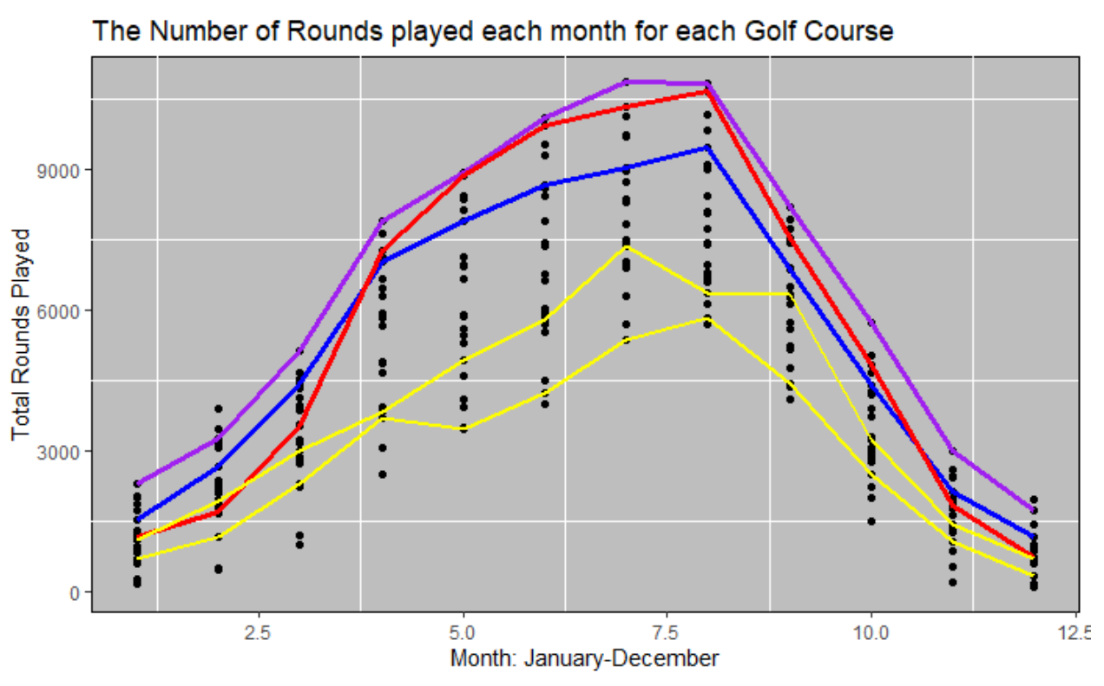
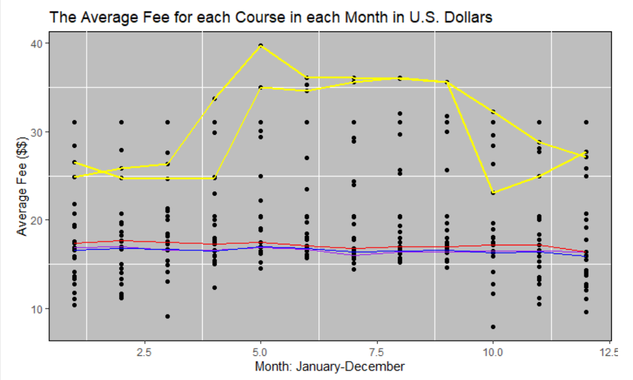
Initial Charts: FEE, ROUNDS
MGS courses:
Two Most expensive non MGS courses

Slide 8
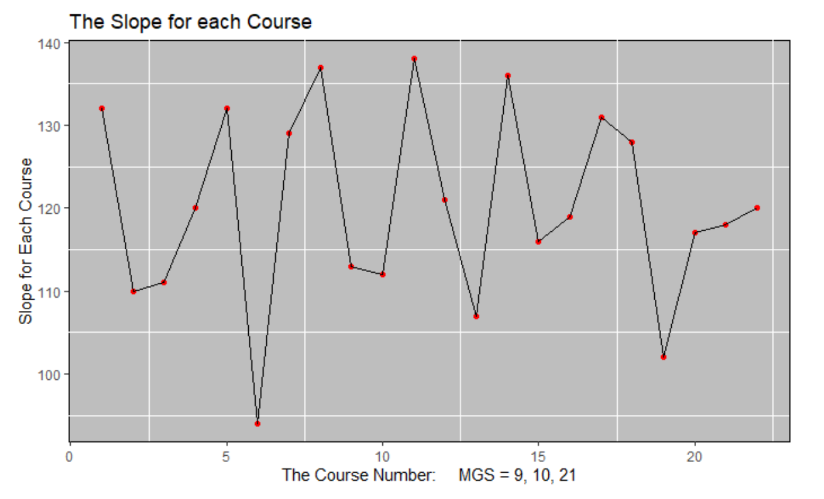
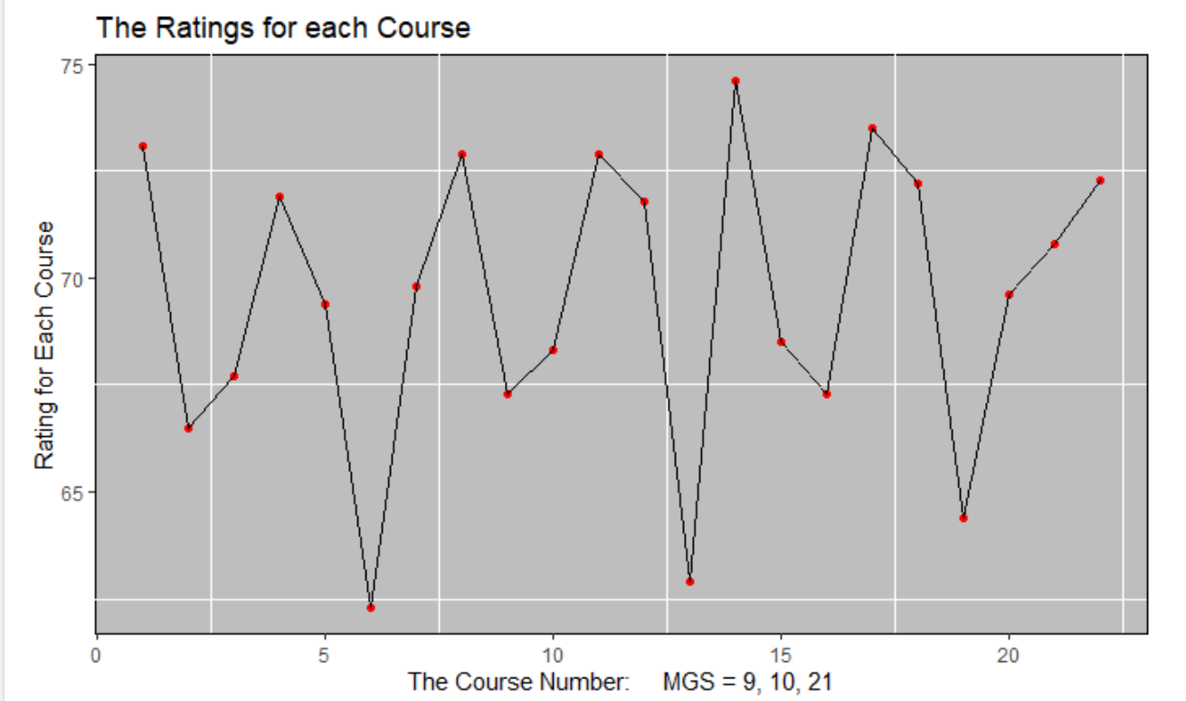
Initial Charts 2: RATING, SLOPE:
Yellow circle represents MGS Courses

Slide 9
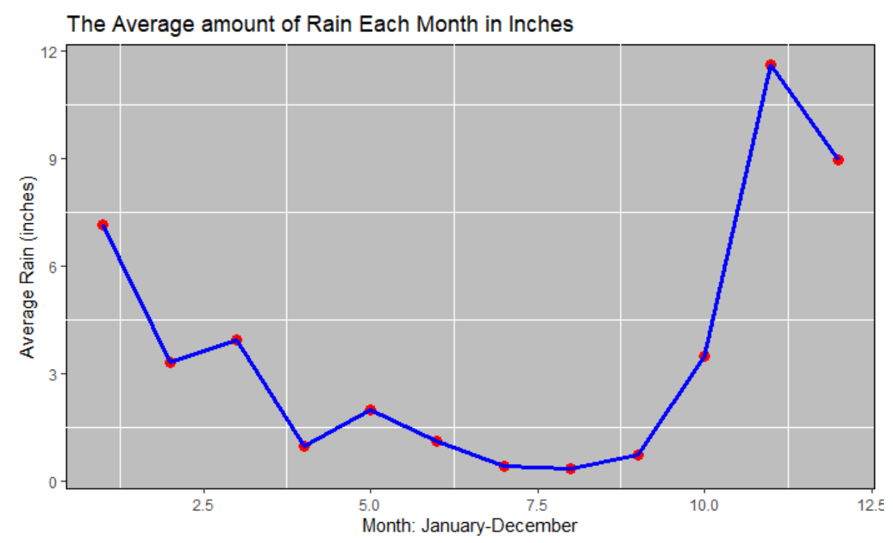
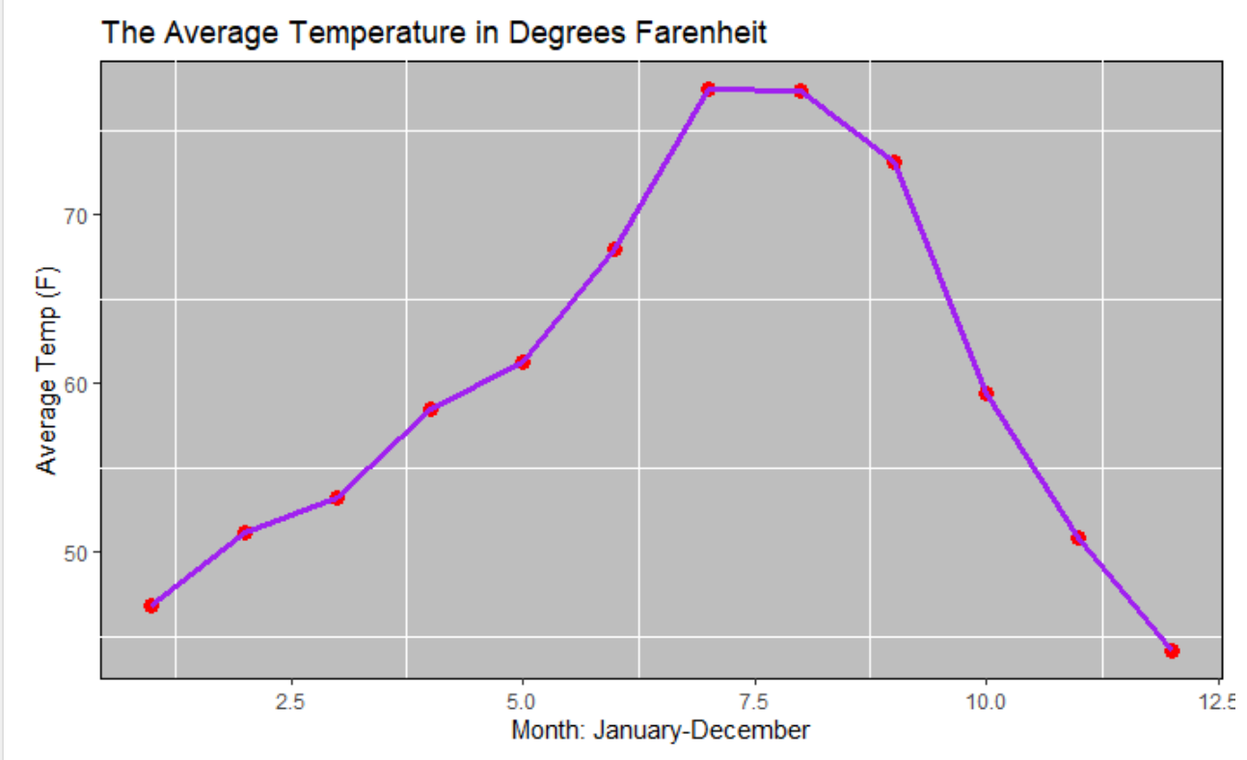
Initial Charts 3: RAIN, TEMP

Slide 10
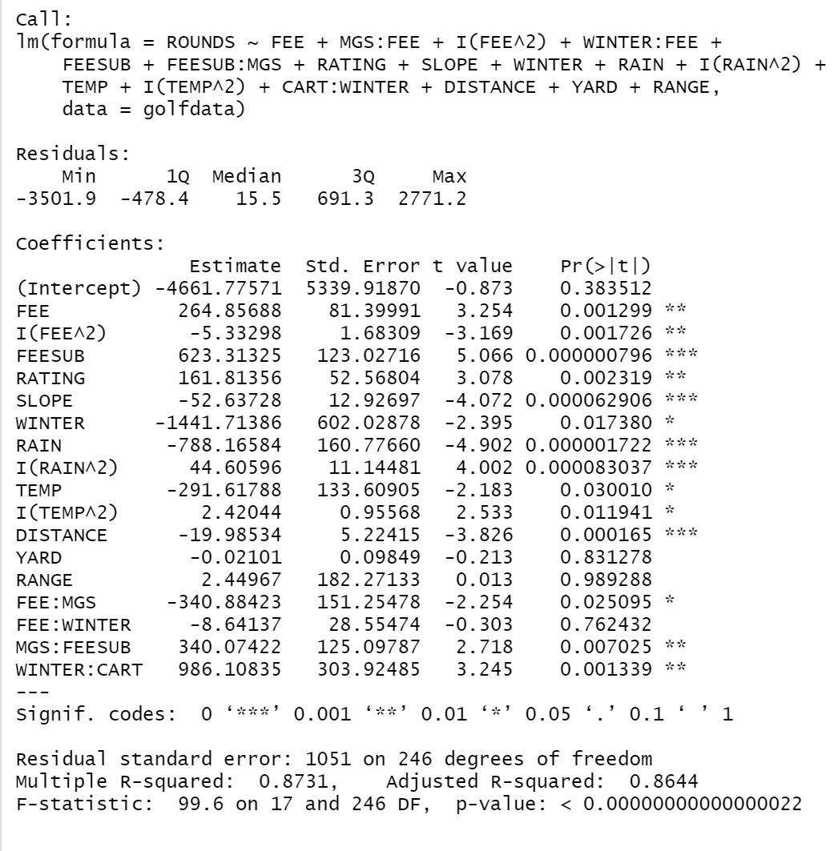
Initial Unrestricted Model:
Interaction Terms:
Squared Terms
Cologne Terms
P-values:
Very High:
YARD
RANGE
WINTER:FEE
R-Squared:
0.8731: Good fit
Next: Conduct F-Wald Tests

Slide 11
Part 2: F-Wald Tests and Auxillary Regression
Presented by Eric Browne

Slide 12
F-Tests: Test for significance
Steps:
Identify Explanatory variables with high p values
Conduct F-Wald Tests on those variables:
Hypotheses:
Null: The variable in question is statistically significant to the model
Alternative: The variable is not significant to the model.
If F-stat is > 0.05, variable is not significant

Slide 13
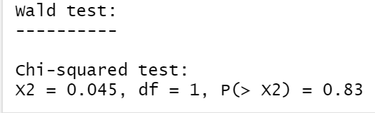
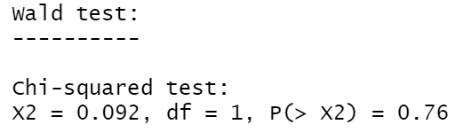
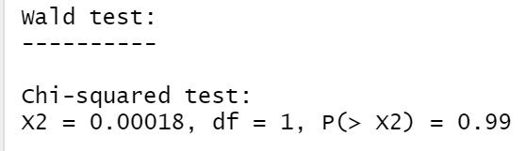
F-Test(s) Results
YARD Variable: Reject the Null
Pull it out!
WINTER:FEE Variable: Reject the Null
Pull it out!
RANGE Variable: Reject the Null
Pull it out!

Slide 14
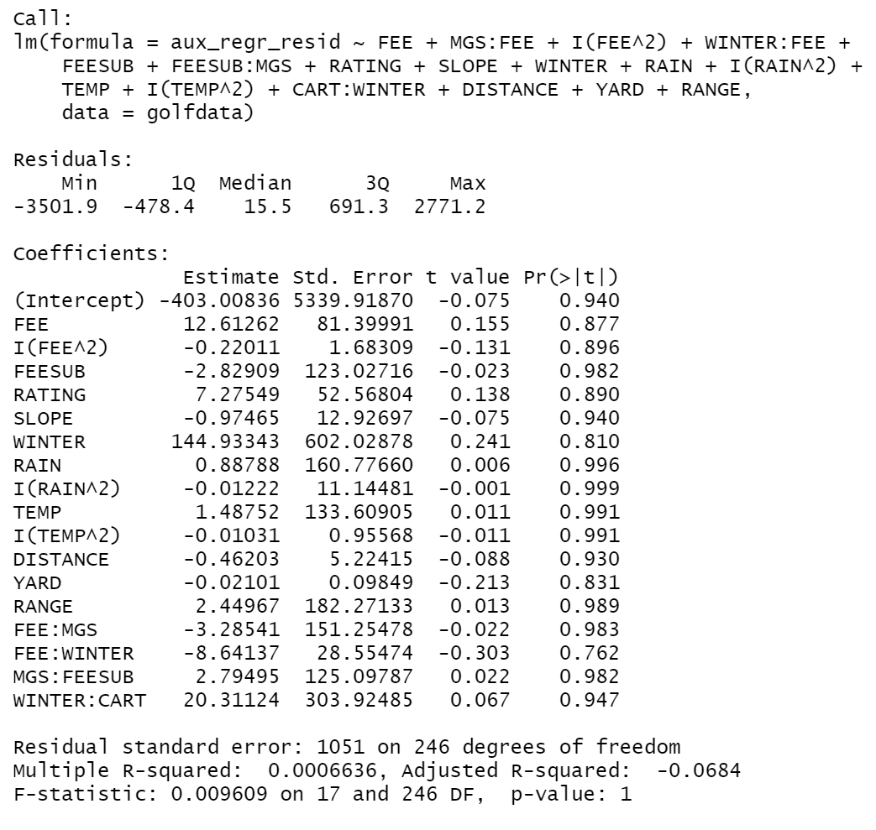
Auxiliary Regression:
Steps:
Run regression: Restricted Residuals on Unrestricted Explanatory Variables
Compute Chi-Squared test statistic:
N*R^2
Compute Chi-Squared Critical Value from table
Hypotheses:
Null: We can omit the variables in question
Alternate: We cannot omit the variables in question
Our Case:
ChSq stat: 0.0019908
ChSq Crit:
7.81
FAIL TO REJECT

Slide 15
Part 3: Heteroskedasticity and Robust Regression
Presented by Eric Browne

Slide 16
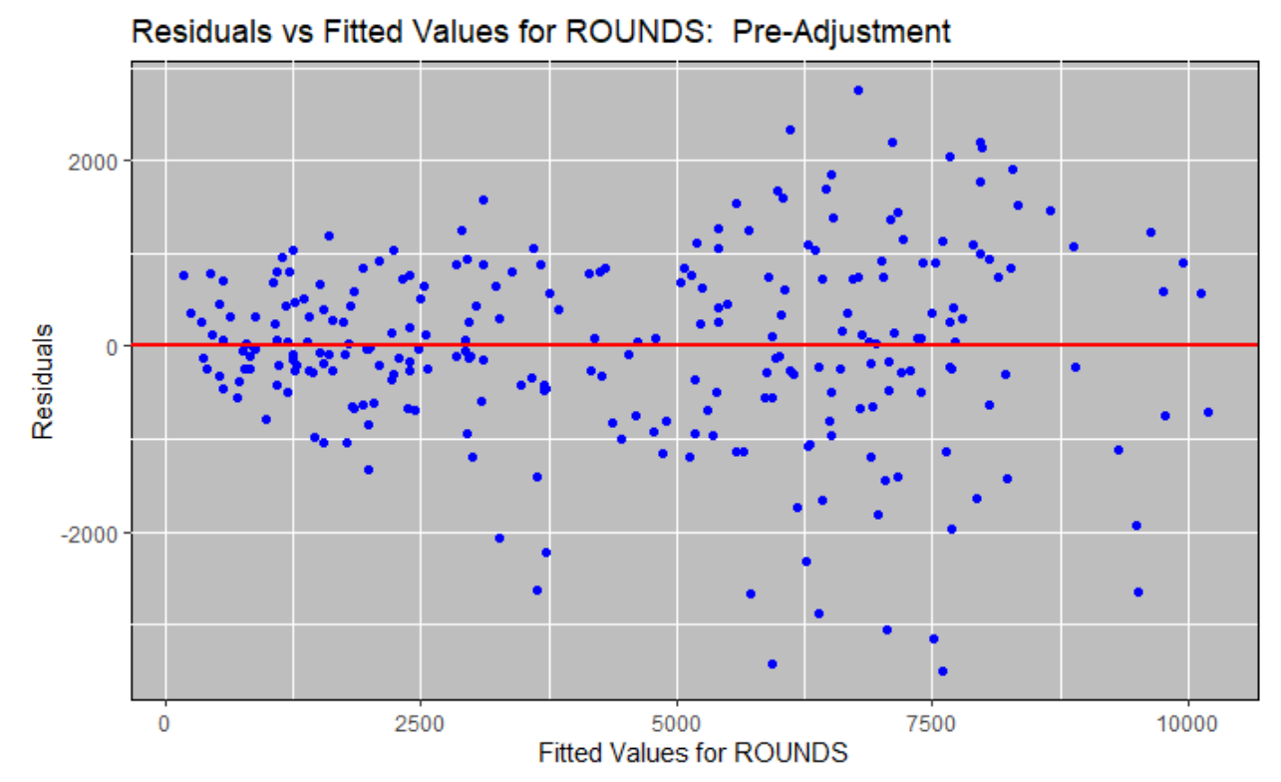
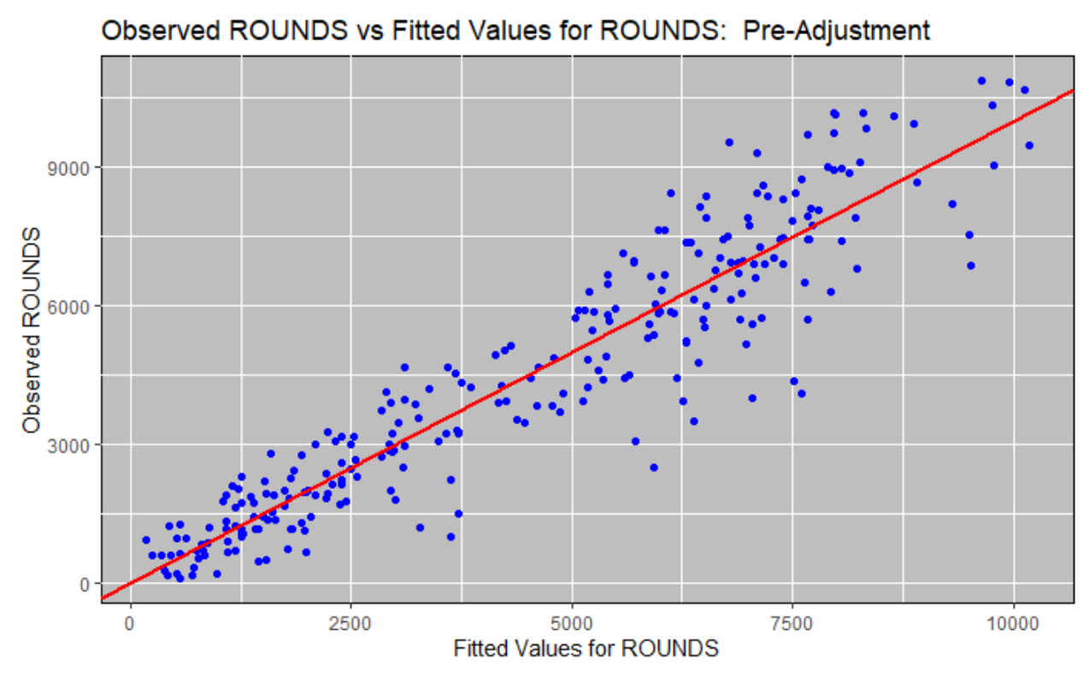
Initial Plots: Residuals vs Fitted Values, ROUNDS, vs fitted values

Slide 17
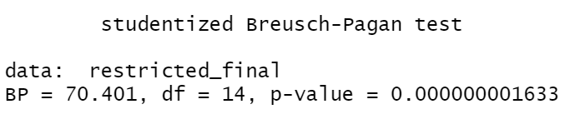
Check for Heteroskedastity
Breusch-Pagan test:
Hypotheses:
Null: There is Heteroskedasticity present in the model
Alternate: The model is homoskedastic (not heteroskedastic)
Violated Gauss-Markov Assumption:
No longer BLUE
Since we fail to reject the Null hypothesis, we have to adjust the Standard Errors in the model
Can no longer conduct T-tests on model
P-value < 0.05

Slide 18
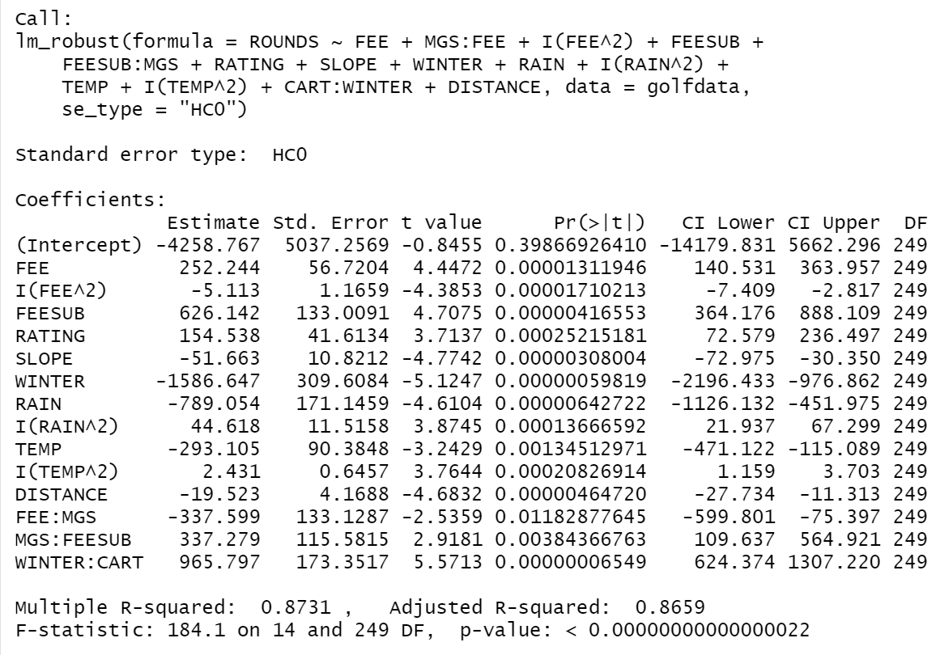
Adjust Model using Robust Regression:
Adjust Standard Errors using White’s Standard Errors: “HCO”
Now the model is Homoscedastic
Estimates of coefficients are the same as Restricted OLS
Standard Errors are smaller

Slide 19
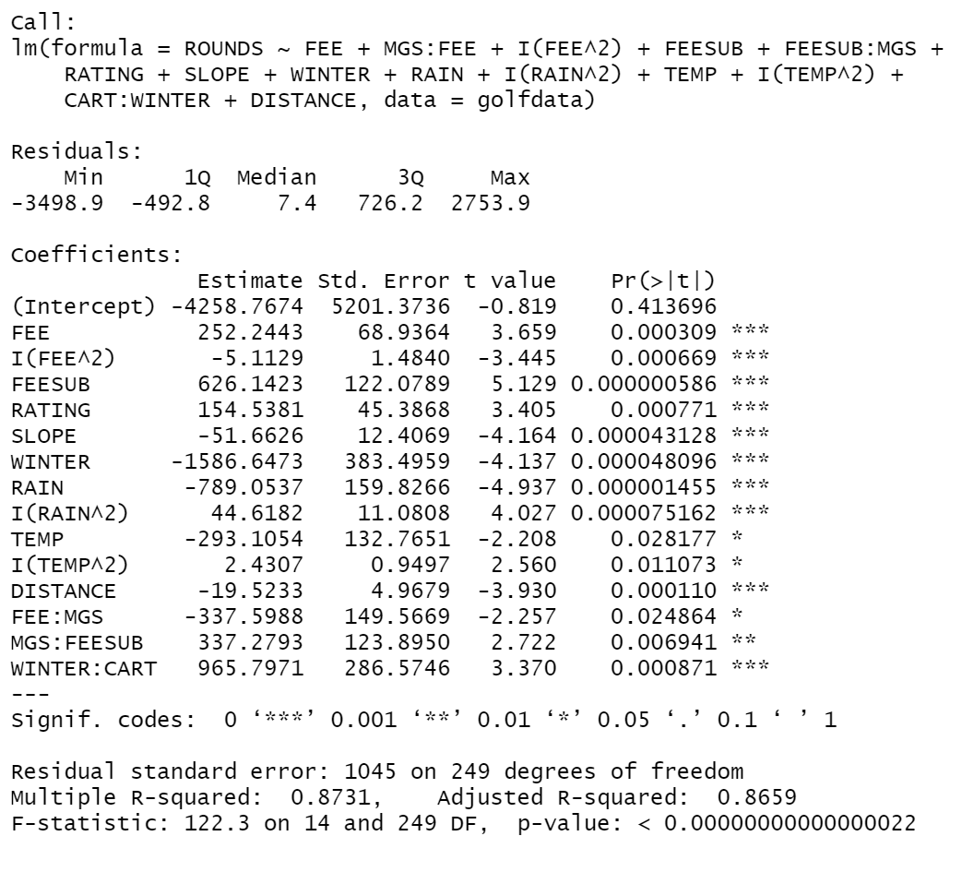
Robust Regression
Regular OLS Restricted Regression
Green indicates a decrease in Standard Error

Slide 20
Part 4: Conclusion
Presented by Eric Browne and Oscar Pachon

Slide 21
Conclusion:
Final Regression:
Is the amount of Golf played (ROUNDS), constant throughout the whole year?
ANSWER: WINTER, RAIN, WINTER:CART, TEMP, FEESUB
Does one season(s) have more demand than the others?
ANSWER: Yes in the summer

Slide 22
El Fin

